Slide 1
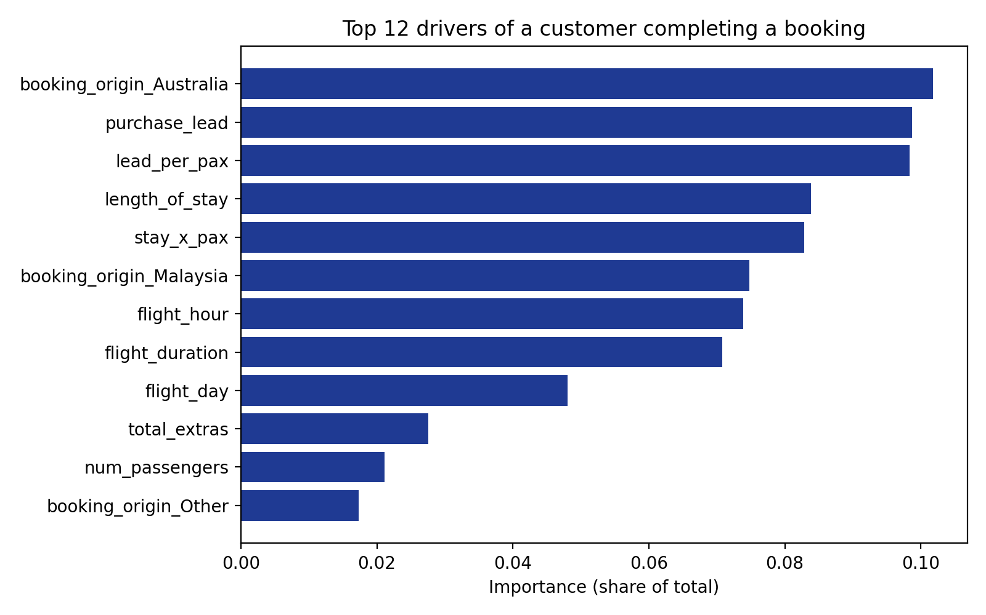
What drives a customer to complete a booking?
RandomForest model on 50,000 customer booking attempts (15% completed a booking)
Top 12 variables by importance
0.77
50%
34%
AUC (5-fold CV)
Recall
Precision
Key findings
Market matters most. 34% of Malaysia-origin customers book vs 5% from Australia.
Trip planning is key. 3-7 day stays convert at 19% vs 10% for 14-30 days.
Extras signal intent. 19% book when all 3 extras are chosen vs 11% with none.
Next step: target high-converting markets and promote extras early in the booking flow.
Engineered features: lead_per_pax, stay_x_pax, total_extras. Metrics from 5-fold cross-validation (hold-out test AUC 0.78). Importance shows association, not cause.

